Slide 1
Fair-Share Spending
Proposing a New Voting Method
For Participatory Budgeting
Robert Tupelo-Schneck
schneck@gmail.com
Robert Loring
votingsite@gmail.com
www.AccurateDemocracy.com

Slide 2
Contents
Problems with the usual voting method used for Participatory Budgeting
Fair-Share Spending: a new voting method

Slide 3
Problems with Usual Method
Usual method:
  Each voter has a set number of votes
  Projects with most votes are funded until money runs out
Problems
  Tactical voting
  Plurality rule
  Not cost-aware

Slide 4
Tactical Voting
When a voter votes “other than his or her
sincere preference in order to prevent an undesirable outcome” (Wikipedia)
Voters don’t want to waste their votes
The voting system forces them to think tactically about how to make their vote count, rather than just voting their sincere preferences
Notes:
It's not just when some voters try to 'game the system'
It's not just attempts at 'gaming the system'
a backup: Ways for small groups to game 'Dot Voting'
1) Quickly put a bunch of dots on your favorite for a 'bandwagon' or 'cascade' effect. 2) Wait till the end; look for a near winner you like; give it enough votes for victory – you want to cast decisive votes ]
[It is most often defensive; as they worry about ]
Voters don’t want to waste their votes
The voting system forces them to think tactically about how to make their vote count, rather than just voting their most preferred result

Slide 5
Tactical Voting
Don’t vote for a sure loser—that would be throwing your vote away
Don’t vote for a sure winner—that would be throwing your vote away
Bullet voting
  If you strongly desire one project, then vote for that project only
  Because voting for lower choices could make one of them beat your favorite and make it lose
Notes:
Don’t vote for a sure winner—that would be throwing your vote away
It does not need your vote. It can't use your vote.
Because voting for lower choices could make one of them beat your favorite and make it lose.

Slide 6
Tactical Voting
Better: a voting system where voters can feel confident in expressing their sincere preferences
  That it will not result in a wasted vote
  That it will not hurt their most important preferences
Notes:
Better: a voting system where voters can feel confident in voting their sincere preferences
Better: a voting system that can give voters confidence when expressing their sincere preferences
Better: a voting system that can give voters confidence to express their sincere preferences
Better: a voting system in which voters can feel safe expressing their sincere preferences
That it will not reduce the amount of the budget that they have a say over

Slide 7
Problems of Plurality Rule
The largest group of voters can control all the money
If the largest group is divided, a minority can control all the money
Notes:
In the usual voting method, a plurality can control all the money, if the rest of the voters are divided
If the largest group of voters is not divided and they do not vote for cheap projects, they can control all the money

Slide 8
Problems of Plurality Rule
Voters
Funds
20%
20%
20%
40%
Notes:
This group gives 20 votes to ABCD and E
This group gives 20 votes to
This group gives 40 votes to PQRS and T
So they win all the money
And the other groups get nothing

Slide 9
Problems of Plurality Rule
Voters
Funds
20%
20%
FGHIJ
ABCDE
20%
KLMNO
P
40%
PQRST
Q
T
R
S

Slide 10
Proportional Voting Rule
Voters
F
Funds
20%
A
20%
FGHIJ
ABCDE
20%
KLMNO
K
40%
PQRST
P
Q

Slide 11
Problems of Plurality Rule
Better: a proportional voting rule to let each large-enough group control their fair share of money
Notes:
Better: a proportional voting rule which allows (sufficiently large) subgroups to control amounts of money in proportion to their size
Better: a proportional voting rule to give all large groups control over their fair shares of money
Better: a proportional voting rule to let each large group control their fair share of money
Also, preferential voting to prevent a diverse subgroup from splitting into fragments too small to control part of the funding
Also, .. to help groups split by many proposals focus their strength on funding their best ones
Also, .. to organize votes from a group split by many proposals so they can fund their best ones
Also, .. to help a group split by too many proposals to organize their strength and fund their best ones

Slide 12
Cost-Aware Voting
The old voting method doesn’t account for even wide variations among the costs of projects
In Chicago's pioneering 2010 PB vote, projects ranged from $2,600 to $230,000... almost the difference between pennies and dollars
But the cheap project needed to win just as many votes as the costly project
And a vote for the cheap project “used up” as much of a voter’s power as the costly project
Notes:
But the cheap project required just as many votes as the expensive one to win; and voting for the cheap project “used up” as much of a voter’s vote as the expensive one
But the cheap project needed to win just as many votes as the costly project;
And a vote for the cheap project “used up” as much of a voter’s power as the costly project (would (use))
Don’t vote for cheap projects
That would be throwing most of your vote away, reducing the portion of the budget that your vote has a say over

Slide 13
Cost-Aware Voting
The most cost-effective projects maximize
voter satisfaction per dollar spent
So consider not only how many voters support a project, but also its cost
In the Chicago example, take a look at how many dollars would be spent funding a project for every vote supporting it, the dollars per vote
Notes:
Background: Voter satisfaction per $ is a major goal
We measure it by the total votes for a set of winners or by the $ per vote for one winner
The most cost-effective projects maximize voter satisfaction per dollar spent
Maximizes voter satisfaction per dollar spent
Funds projects with low cost per benefit [~“$/vote”]
Benefit is measured in votes
The projects with low cost per benefit maximize voter satisfaction per dollar spent [~votes/$1000]

Slide 14
Traffic/Pedestrian Signal @ Clark & Chase: $230,000, 494 votes, $466/vote
Intersection Safety @ Clark & Farwell: $2,600, 334 votes, $8/vote
Speed Humps on 1100-1200 W Greenleaf: $3,500, 181 votes, $19/vote
Police Camera @ Sheridan & Greenleaf: $13,000, 246 votes, $53/vote
Police Camera @ Damen & Rogers: $13,000, 235 votes, $55/vote
Free Wi-Fi on 1600-1700 W Howard: $24,600, 334 votes, $74/vote
St. Repair 1300-1500 Jarvis, 7000 Paulina: $13,000, 171 votes, $76/vote
Street Lighting 1400-1600 W Juneway: $13,000, 161 votes, $81/vote
Renovate Cultural Center at Berger Park: $25,000, 269 votes, $93/vote
Street Lighting 1500-1600 W Greenleaf: $65,000, 277 votes, $235/vote
Police Camera at Lunt & Paulina: $55,000, 155 votes, $355/vote
Notes:
Here's the most expensive winner
Here are some losers that had far lower costs per vote won
It is possible but not likely that 342 voters happened to cast all 2,363 votes for the 10 projects which replace the 1 costly project supported by 466 voters.
Did those 466 voters contribute to any other winners?

Slide 15
Traffic/Pedestrian Signal @ Clark & Chase: $230,000, 494 votes, $466/vote
10 projects
$227,700
2363 votes (not distinct voters!)
$96 / vote
Cost-aware voting gives more voters more of what they want for the same cost
= more satisfied voters
Notes:
Compared with 1 project $230,000, 494 votes, $466/vote
It’s harder to fund a large project...
… and it should be
And not impossible:
Sidewalk repairs: $188,292, 910 votes, $207 / vote

Slide 16
PB in Cambridge Mass. 2015
Central Square toilet $320,000; 945 votes, $339/vote
Little free libraries $13,000, 620 votes, $21/vote
Bus shelter real-time monitors $30,000, 748 votes, $40/vote
Wayfinding banners $15,000, 246 votes, $55/vote
O'Connell Library furniture $36,000, 634 votes, $67/vote
Russel Field mural $22,600, 289 votes, $76/vote
Planting materials $40,000, 506 votes, $79/vote
Raymond Park com. Garden $20,000, 193 votes, $104/vote
Danehy fitness equipment $65,000, 468 votes, $139/vote
83 bus shelter renovation $75,000, 271 votes, $277/vote
Notes:
Here's the most expensive winner
Here are some losers that had far lower costs per vote won
It is possible but not likely that 342 voters happened to cast all 2,363 votes for the 10 projects which replace the 1 costly project supported by 466 voters.
Did those 466 voters contribute to any other winners?

Slide 17
Central Square toilet $320,000; 945 votes, $339/vote
9 projects
$316,000
3902 votes (not distinct voters!)
$81 / vote
Cost-aware voting gives more voters more of what they want for the same cost
= more satisfied voters
Notes:
Compared with 1 project $230,000, 494 votes, $466/vote
It’s harder to fund a large project...
… and it should be
And not impossible:
Sidewalk repairs: $188,292, 910 votes, $207 / vote

Slide 18
Contents
Problems with the usual voting method used for Participatory Budgeting
Fair-Share Spending: a new voting method

Slide 19
Fair-Share Spending: Core Idea
Each voter controls an equal share of the money
It will fund his/her favorite projects
If the voter wants to spend money on a project which doesn’t get enough support, the voter’s money moves to his or her next favorite
Notes:
Precise for an educated audience?
Give each voter an equal share of the total budget
And spend their share as much as possible according to their preferences
Simple for a less educated audience?
A voter guides an equal share of the money
It will move to support his/her favorite projects
- - -
If it moved to the least-funded project,
then it moves on to the voter's next favorite.

Slide 20
Fair-Share Spending: Example
$9000, 3 voters
Each voter has a $3000 share

Slide 21
Fair-Share Spending: Example
A
B
C
D
E
F
G
Projects for $2000, $3000, or $4000
Each voter may distribute his or her share among the projects

Slide 22
Fair-Share Spending: Example
A
B
C
D
E
F
G

Slide 23
Fair-Share Spending: Eliminations
A
B
C
D
E
F
G
✓
Some projects win
Not all projects can win
So the least popular must lose
But its voters don't lose their share of power
Each guides their money to their next choice!
Notes:
Not all projects can win [There isn't enough money]
But don’t waste the votes (that is, money) of voters who supported them
Transfer money to voter’s next preferences!
Not all projects can win [There isn't enough money]
So the least popular must lose [one at a time]
But its voters don't lose their share of power [that is, money]
Each guides their money to their next choice
or
So eliminate the least popular [one at a time]
But its voters still have their share of power [money]
Move the money to each voter’s next choice!

Slide 24
Fair-Share Spending: Eliminations
A
B
C
D
E
F
G
✓

Slide 25
Fair-Share Spending: Eliminations
A
B
C
D
E
F
G
✓

Slide 26
Fair-Share Spending: Eliminations
A
B
C
D
E
F
G
✓

Slide 27
Fair-Share Spending: Surplus
A
B
C
D
E
F
G
✓
If a project is offered more money than it needs:
Let each voter transfer his/her part of the surplus to the voter’s next preference!
It costs less to support projects with many supporters!
Notes:
Allow each voter to transfer a portion of his/her support to next preferences!
Allow each voter to transfer a portion of his/her support to his/her next preference!
Let each voter transfer his/her part of the surplus to his/her next preference!

Slide 28
Fair-Share Spending: Surplus
A
B
C
D
E
F
G
✓

Slide 29
Fair-Share Spending: Surplus
A
B
C
D
E
F
G
✓
✓

Slide 30
Fair-Share Spending: Example
A
B
C
D
E
F
G
✓
✓

Slide 31
Fair-Share Spending: Example
A
B
C
D
E
F
G
✓
✓
✓
Notes:
The maximum vote here was 50%
The maximum vote a voter is allowed to give a project in this simple example is 50%. So each project needs at least 2 voters to support funding.

Slide 32
Ranked-Choice Voting
A real tally can't stop to ask each voter for their next choice if their top choice loses
So we ask each voter to rank the projects
Notes:
In a real election, can’t ask voters what their next preferences are, when their higher preferences are eliminated
A real tally can't stop to ask each voter for their next choice if their top choice loses

Slide 33
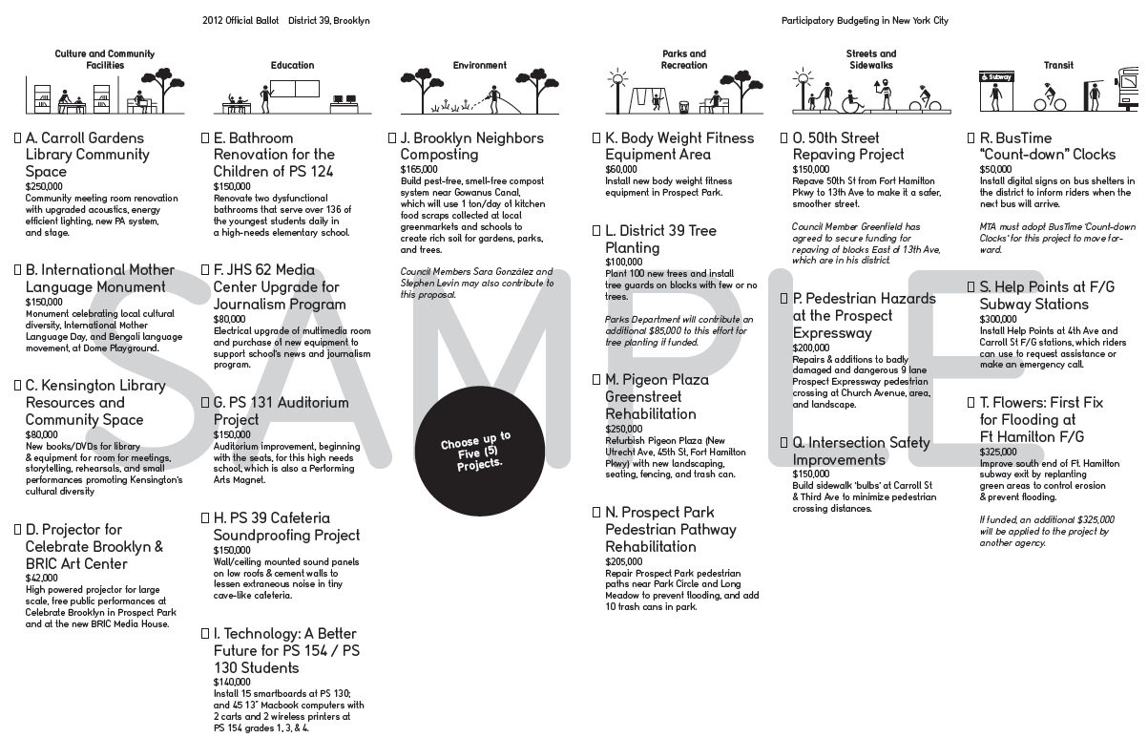
Notes:
There are several styles
Here's one used at Twin Oaks
(They'll give a talk in the next session)
I can click to put a project on my list
And slide it up or down my list to change its rank

Slide 34
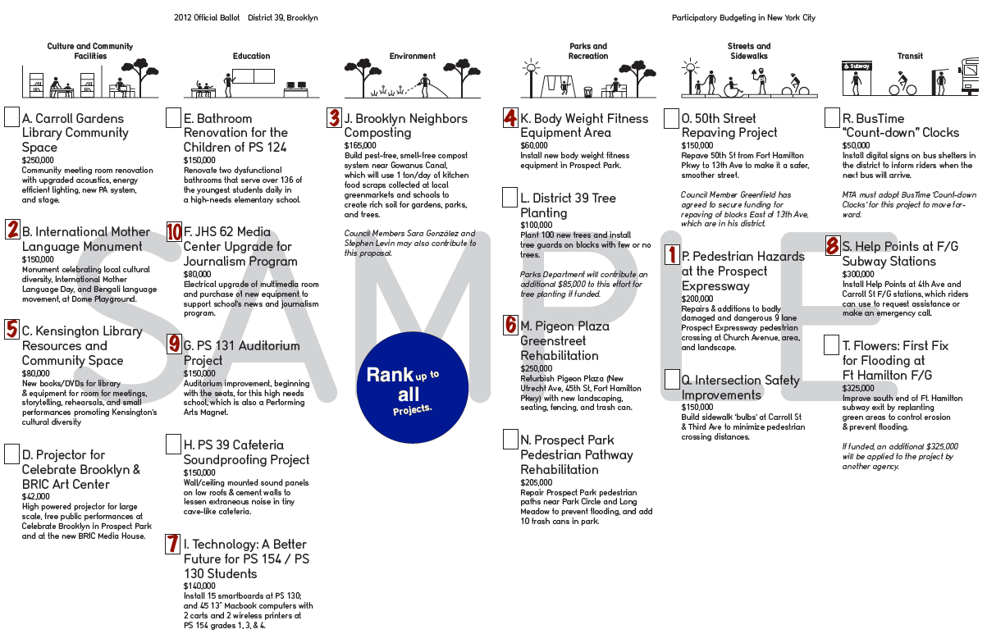
Notes:
It’s not necessary to rank all projects, but voters should be encouraged to rank as many as they might be willing to support... since their highest preferences may not win, they want to have lower preferences for their money to move to

Slide 35
Single Transferable Vote
The Fair-Share Spending system – with
ranked-choice voting and transfer of votes – develops from a voting method known as
the Single Transferable Vote (STV)
STV is the multi-winner version of Instant-Runoff Voting (IRV), also known as the Alternative Vote or Ranked-Choice Voting

Slide 36
Single Transferable Vote
Used nationally:
  Ireland
  Australia
  Malta
Used widely in local elections:
  Scotland
  New Zealand
In North America:
  Cambridge, MA
  Minneapolis, MN
Notes:
STV is used all over New Zealand to elect the public health councils.

Slide 37
Fair-Share Spending: Benefits
Fair-Share Spending is fair
  Each ballot controls the same amount of $
  The largest group can’t control more than its share
  Large minority groups can control their shares of money
Fair-Share Spending is cost-aware
  Fair to less-costly projects and their supporters
  Promotes efficient use of money
  Increases voter satisfaction per dollar spent
Notes:
Minority groups can control money proportional to their share
Minority groups can control their shares of money
- few wasted votes - so no *worries* about tactics
- more fair to the (non tactical) sincere voters
We can't know if a voting method is “fair share” unless we keep track of each voter's share.
We can't push voters to be cost effective unless they know they use up their shares to pay for projects.
Promotes cost-effective projects || good use of $
Picks “cost-effective” projects as defined by voting
Fair to a project of any price and to its supporters

Slide 38
Fair-Share Spending: Benefits
Votes for unpopular projects aren’t wasted,
and votes for popular projects cost less
  Less incentive for tactical voting
  More votes for the winning set of projects
  A stronger mandate for the decision
Voters know that their vote counts
  Literally: their ballot controls a fair share of the $
Notes:
Votes for unpopular projects aren’t wasted,
and votes for popular projects [cost less]
Less incentive for tactical voting
+ [Less worry and disadvantage for other voters]
More voters define the winning set of projects
More legitimacy for the final decision

Slide 39
Fair-Share Spending: Benefits
With these benefits, we can hope to:
  Increase voter turnout and satisfaction
  Encourage more officials to entrust PB with
  more money in more cities
Notes:
Fair-share voting builds trust in group spending,
and may raise support for more of it.

Slide 40
Fair-Share Spending
Electoral reform is hard
Because participatory budgeting is still young, we have a unique opportunity to introduce better voting methods now – voting methods that are more expressive and more fair
Notes:
Voting reform is hard because less fair methods are now entrenched by centuries of use.

Slide 41
Fair-Share Spending
Proposing a New Voting Method
For Participatory Budgeting
Robert Tupelo-Schneck
schneck@gmail.com
Robert Loring
votingsite@gmail.com
www.AccurateDemocracy.com

Slide 42
Tactical Voting
Don’t vote for cheap projects
  That would be throwing most of your vote away, reducing the portion of the budget that your vote has a say over
  (Of course, a voter who votes for all losers ends
  up with no say over any of the budget!)
Especially unfortunate: this may actively discourage considering which projects are most cost-effective
Notes:
This says little about plurality rule, and that is OK. The 5 vote ballot can give all power to a handful of big groups if they vote for expensive projects. But if many low-cost projects win, some will likely go to smaller groups (like Limited Voting).
It reduces the portion of the budget that your vote has a say over, and thus the power of your vote
A voter who votes for several expensive winners controls a larger portion of the total budget than a voter who votes for cheap projects
Votes for expensive winners control a larger portion of the budget power than votes for cheap ones.
This is included, we just have to hope they get it: Especially unfortunate... proposing more cost-effective projects

Slide 43
Tactical Voting
Better: a voting system where voters can feel confident in expressing their sincere preferences
  That it will not result in a wasted vote
  That it will not hurt their most important preferences
  That it will not reduce the amount of the budget that they have a say over
Notes:
Better: a voting system where voters can feel confident in voting their sincere preferences
Better: a voting system that can give voters confidence when expressing their sincere preferences
Better: a voting system that can give voters confidence to express their sincere preferences
Better: a voting system in which voters can feel safe expressing their sincere preferences

Slide 44
Problems of Plurality Rule
If the largest group of voters is not divided and they do not vote for cheap projects, they can control all the money
If the largest group is divided, a minority can control all the money
Notes:
In the usual voting method, a plurality can control all the money, if the rest of the voters are divided

Slide 45
Problems of Plurality Rule
Voters
Funds
60%
ABCDFGJKLMNO
P
40%
PQRST
Q
T
R
S
Notes:
- 40% could control the entire budget if the other 60% are divided
- but 40% should control only 40%
Here's a place where there is one big group, more than half of the voters, but they are very creative and they propose lots of projects
These problems are often hard to see, go unnoticed
The interest groups might be less clear
The majority might win one or two

Slide 46
Cost-Aware Voting
It’s harder to fund a large project...
… and it should be
And not impossible:
Sidewalk repairs: $188,292, 910 votes, $207 / vote
Notes:
Next slide:
There's a difference between *thinking a project would be good to have* and actually wanting to spend money on it
There’s a difference between wanting a project, and actually wanting to spend all the money on it
There’s a difference between wanting a project, and actually wanting to spend a lot of money on it
Thinking a project would be nice is not the same as wanting to spend all the money on it

Slide 47
Cost-Aware Voting
There’s a difference between wanting a project, and actually wanting to spend money on it
If voters know a costly project uses up more of their power, it may encourage them to vote for the projects they think are most cost-effective
  Not just the ones they want the most
And that may encourage project proposals to be more cost-effective
Notes:
If voters know that the voting takes cost into account, it may encourage them to vote for projects they think are most cost-effective
If a voter knows that a more costly project uses up more of their power, it may...
If a voter knows their share of the money must help pay for a project's cost, it may...
If voters know the tally charges them for costs, it may...
If voters know the tally charges their shares of power for costs, it may...
We can't push voters to be cost effective unless they know they use up their shares to pay for projects.

